Slide 1
CIS8695 Managing Big Data Analytics
Nasim Mousavi
Assistant Professor
J. Mack Robinson College of Business
Georgia State University
nmousavi@gsu.edu

Slide 2
What is Data Science?

Slide 3
Data Science
All about managing big data, extracting managerial insights from it
A multidisciplinary field combining skills in computer science and statistics with domain expertise to support the analysis of large and diverse data sets
As a data scientist you uncover values for an organization and then communicate them to stakeholders as actionable results

Slide 4
Why Data Science Is Trending? Big Data
These days, more data is generated than ever
New data is generated faster than ever
Improvements in computing power and capacity
Progress in algorithms & software tools
All of these create valuable applications, including:
Product recommendations
Marketing analysis
Demand forecasting
Fraud detection

Slide 5
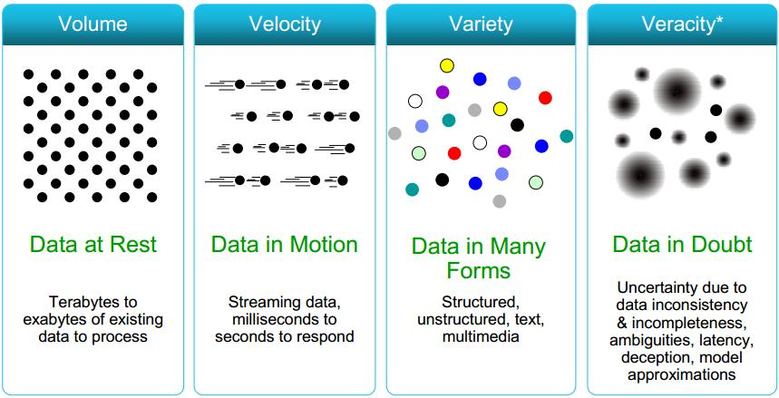
Definition of Big Data: 4Vs
Big data is usually characterized by four Vs

Slide 6
Volume
Volume refers to how much data is actually collected.
These days data has high volume:
Transaction-based data stored through the years
Unstructured data streaming in from social media or smartphone, etc.
Sensor and machine-to-machine data being collected (e.g., IoT)

Slide 7
Variety
Variety refers to how many points of reference are used to collect data.
Data today comes in all types of formats
Structured, numeric data in traditional databases
Information created from line-of-business applications
Unstructured text documents, email, video, audio, stock ticker data and financial transactions
Managing, merging and governing different varieties of data is very complex

Slide 8
Velocity
Velocity refers to how fast data can be generated, gathered and analyzed.

Slide 9
Veracity
Veracity relates to how reliable data is.
An analyst needs to ensure that the data they look at is valid and comes from a trusted source.
Knowledge about where the data comes from and how it is collected.
Testing measures to ensure that data results in the desired information and is not irrelevant.

Slide 10
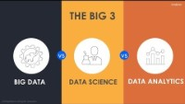

Slide 11
Goal
Predictive modeling to analyze historical data with the goal of identifying trends or patterns,
And then using those insights to predict future outcomes
Estimating the quality of a sales lead,
Estimating the likelihood of spam,
Estimating the probability someone will click a link or buy a product.

Slide 12
Data Science Project Life Cycle

Slide 13

Data Science Project Life Cycle
A typical data science project should follow these steps

Slide 14
Data Analysis Steps:
1. Define Purpose

Slide 15
Define Purpose
The process begins by developing an understanding of the purpose of the project
How will the organization use the results?
Who will be affected by the results?
Will the analysis be a one-shot effort or an ongoing procedure?

Slide 16
Data Analysis Steps:
2. Obtain & Prepare Data

Slide 17
Obtain Data
Involves sampling from a large database to capture records to be used in an analysis
How well this sample reflects the records of interests to ensure the generalizability of the results

Slide 18
Statistical Terms
Population: The group from which data is to be collected
Sample: Subset of population
Variable: Feature characteristics of any member of population
Continuous variables: Age, Weight
Categorical variables: Race, Educational level
Binary variables (0/1): Pass/Fail, Smoker/Non-smoker

Slide 19
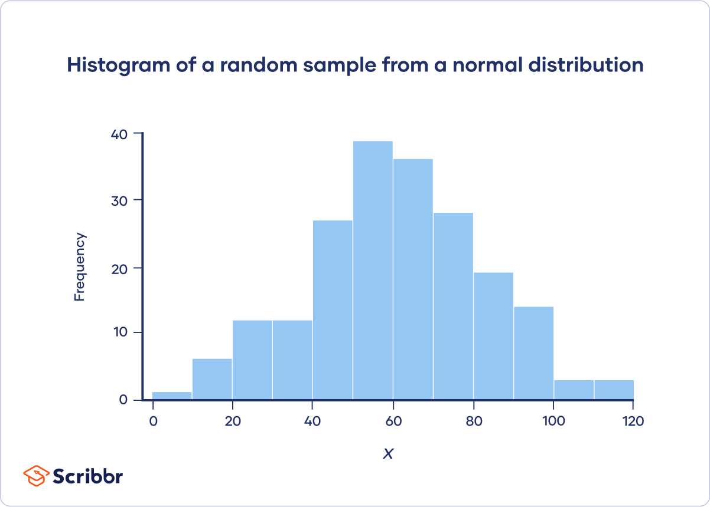
Types of Statistical Measures
Frequency: Number of occurrence of any particular data value in a given dataset.
Measures: Number, Percentage

Slide 20
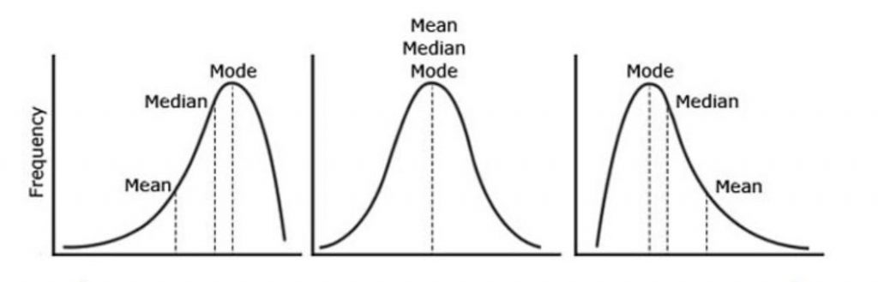
Types of Statistical Measures
Central tendency: Whether a data values accumulates in the middle of the distribution or toward the end.
Measures: Mean, Median, Mode

Slide 21
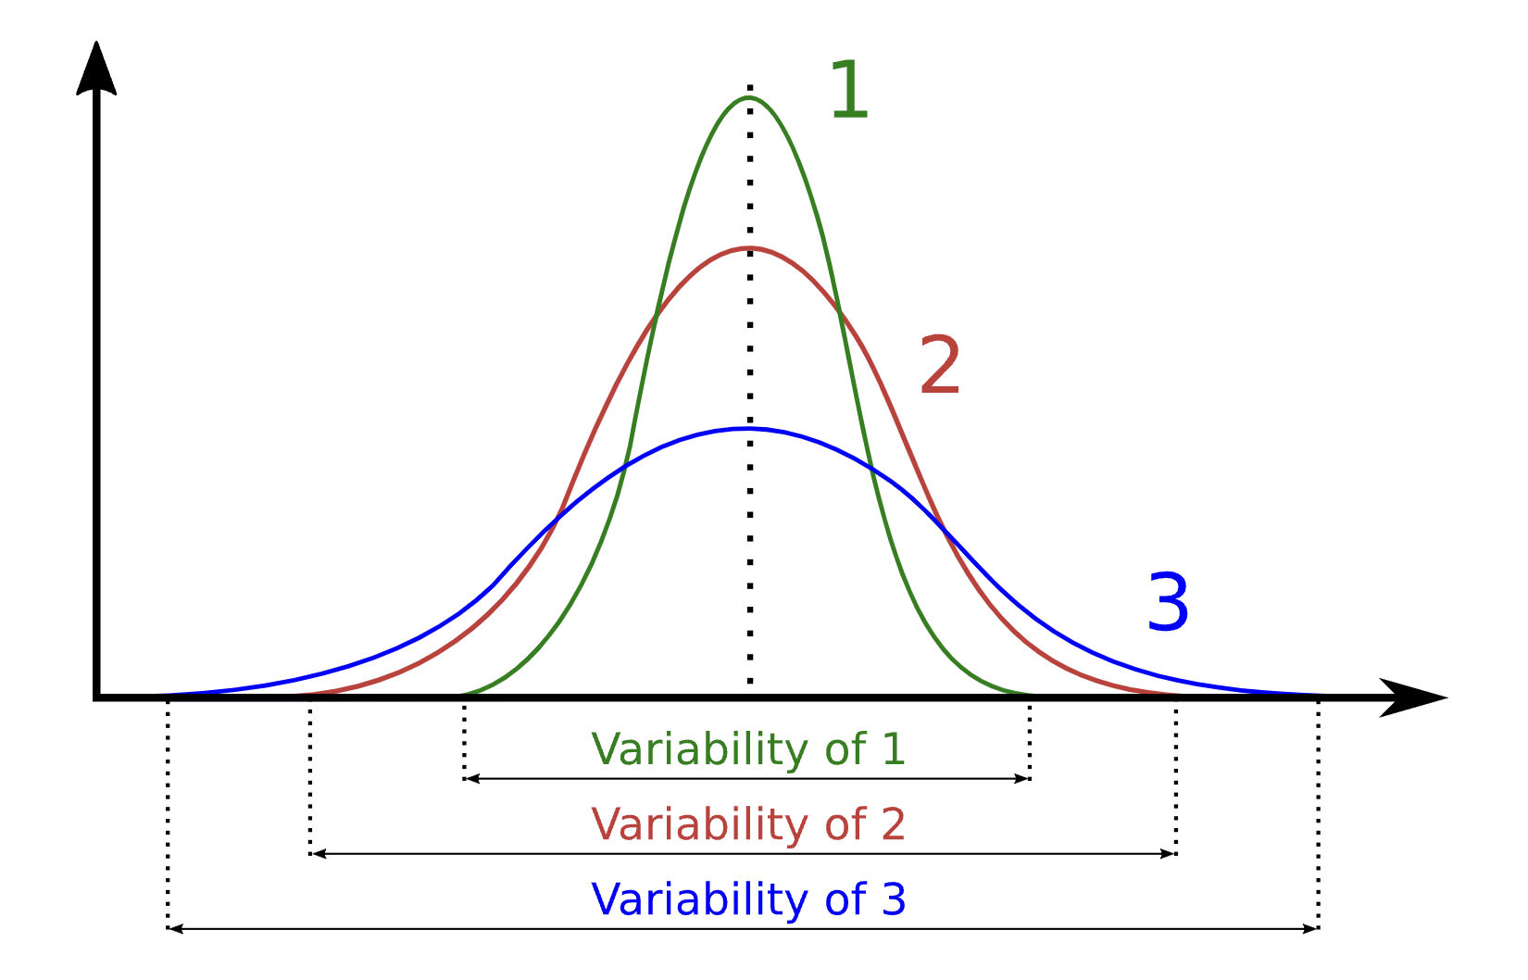
Types of Statistical Measures
Spread: How similar or varied the set of observed values are for a particular variable.
Measures: Standard deviation, Variance

Slide 22
Data Preparation
Need to know:
What types of variables does this data have?
How do the variables relate to each other?
What is a usual value for each variable?
How are variables distributed?
What is the relationship between different variables?

Slide 23
Data Preparation
The first step in a data preparation step is often “Getting to know the data”
Descriptive statistics provide a framework for this
Min, Mean, Max, Std
Plot data to quickly identify trends and features
Calculate numerical values that characterize the data

Slide 24
2.1. Outlier Detection

Slide 25
Outlier Detection
Data may contain “bugs” just as software does
These can be difficult to find and may lead to bias results & invalid conclusions

Slide 26
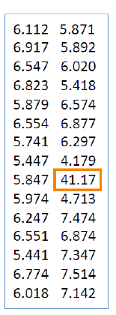
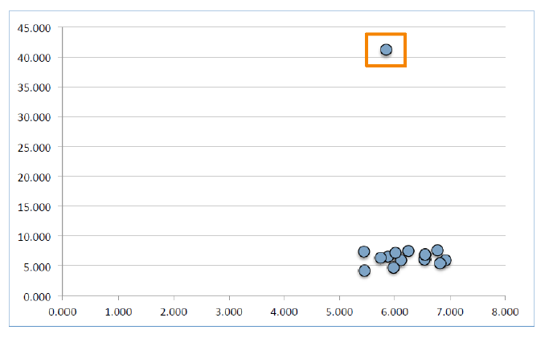
Outlier Detection
Scatterplots help to expose potentially invalid data
Outliers are usually removed from the dataset

Slide 27
2.2. Handling Missing Values

Slide 28
Missing Values
Most algorithms will not process records with missing values. Default is to drop those records.
Solution 1: Omission
If a small number of records have missing values, can omit them
If many records are missing values on a small set of variables, can drop those variables (or use proxies).

Slide 29
Missing Values
If many records have missing values, omission is not practical
Solution 2: Imputation
Replace missing values with reasonable substitutes
mean, median, regression prediction

Slide 30
2.3. Dimension Reduction

Slide 31
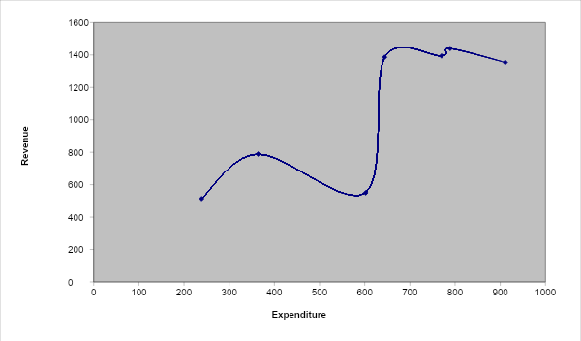
The Problem of Overfitting
Statistical models can produce highly complex explanations of relationships between variables
The “fit” may be excellent
When used with new data, models of great complexity do not do so well
Notes:
31

Slide 32
Dimension Reduction
Sometimes the dimension of dataset, number of variables is huge
And must be reduced for algorithm efficiency, accuracy and reliability:
Multicollinearity: multiple correlated variables
Overfitting

Slide 33
Dimension Reduction Techniques
Incorporating domain knowledge to remove or combine categories
Using data summaries to detect correlated variables (remove or combine redundant variables)
Employing automated reduction techniques, like PCA
A new set of variable is created that are weighted average of the original variables
Using methods, such as regression models, classification methods, like decision tree

Slide 34
Data Analysis Steps:
3. Model Selection

Slide 35
Supervised vs. Unsupervised Learning
Supervised learning: Predicting the outcome variable for new records
Outcome of interest is known, “labeled data”
Training data: from which the model/algorithm “learns”
Validation data: where the trained model is applied to for assessment of performance, and model comparison
Test data: if model selection is involved, test data is used to assess the finally selected model
The outcome in the test data is also known

Slide 36
Supervised vs. Unsupervised Learning
Unsupervised learning
No outcome to be classified or predicted
Let the data tells the story (patterns) by itself, and no predetermined patterns to be learned from training data

Slide 37
Predictive Analytics
Techniques
Regression (e.g., linear, logistic)
Classification (decision trees, random forest, support vector machines, etc.)
Clustering (e.g., k-means, hierarchical)
Association rules & Recommendation Systems
Conventional neural networks
Text classification and topic modeling

Slide 38
Data Analysis Steps:
4. Model Evaluation

Slide 39


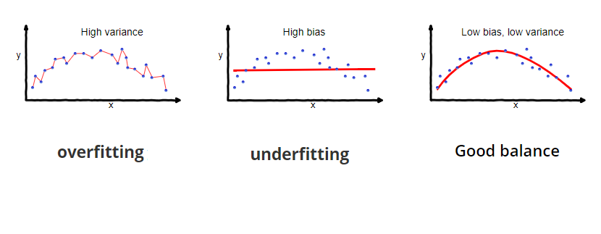
Balance between Bias & Variance
Notes:
39

Slide 40
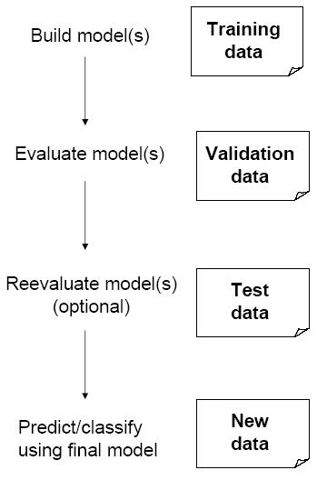
Partitioning the Data
Problem: How well will our model perform with new data?
Solution: Separate data into two parts
Training partition to develop the model
Validation partition to implement the model and evaluate its performance on “new” data
Addresses the issue of overfitting

Slide 41
Test Partition
When a model is developed on training data, it can overfit the training data (hence need to assess on validation)
Assessing multiple models on same validation data can overfit validation data
Solution: final selected model is applied to a test partition to give unbiased estimate of its performance on new data

Slide 42
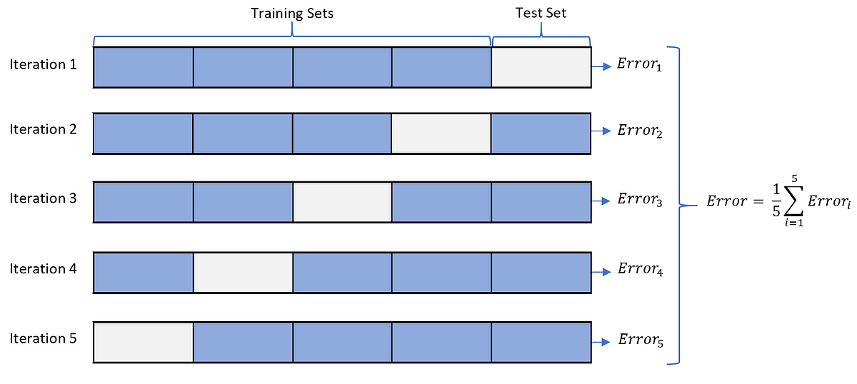
Cross Validation
Repeated partitioning = cross-validation (“cv”)
k-fold cross validation, e.g. k=5
For each fold, set aside ⅕ of data as validation
Use full remainder as training
The validation folds are non-overlapping

Slide 43
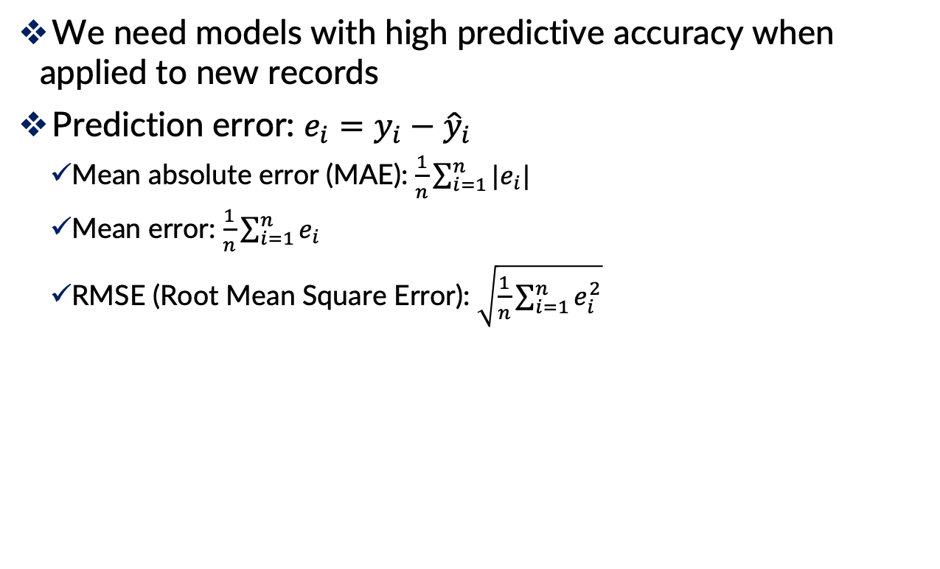
Evaluating Predictive Performance
We need models with high predictive accuracy when applied to new records
Prediction error: $e_{i}=y_{i}−{\hat{y}}_{i}$
Mean absolute error (MAE): $\frac{1}{n}\sum_{i=1}^{n}{|e_{i}|}$
Mean error: $\frac{1}{n}\sum_{i=1}^{n}{e_{i}}$
RMSE (Root Mean Square Error): $\sqrt{\frac{1}{n}\sum_{i=1}^{n}{e_{i}^{2}}}$

Slide 44
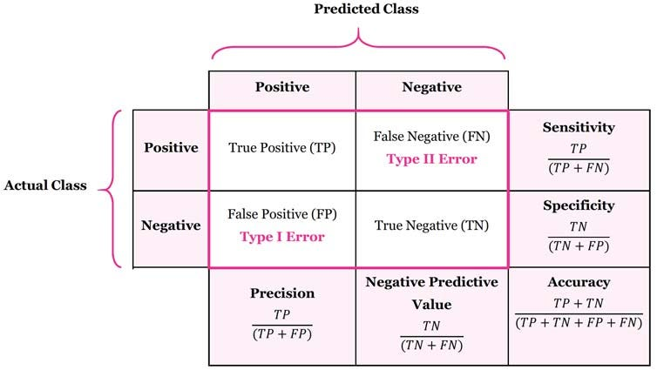
Judging Classifier Performance
Confusion matrix:
Summarizes the correct and incorrect classifications by a classifier

Slide 45
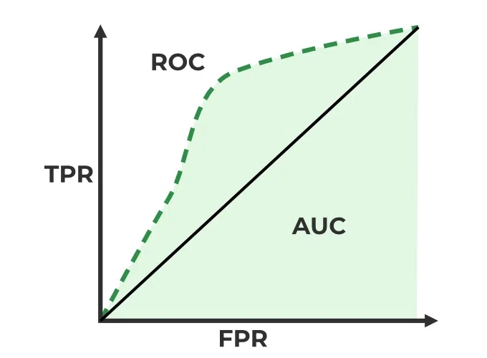
Judging Classifier Performance
ROC (Receiver Operating Characteristics)
The effectiveness of the binary classification model
Plots the true positive rate (TPR) vs. the false positive rate (FPR) at different classification thresholds.
AUC (Area Under the Curve)

Slide 46
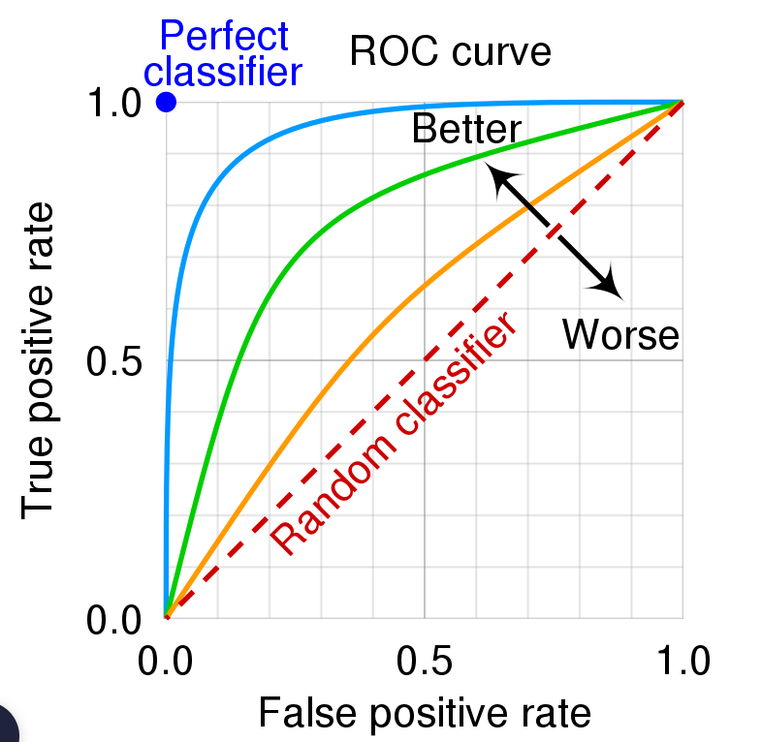
Judging Classifier Performance
A greater value of AUC denotes better model performance
Our main goal is to maximize this area in order to have the highest TPR and lowest FPR at the given threshold

Slide 47
Data Analysis Steps:
4. Deployment

Slide 48
Deploy the Model
This step involves integrating the model into operational systems and running it on real records to produce decisions or actions

